Slide 1
Introduction to botanical leaf vocabulary

Slide 2
Learning outcomes
use scientific vocabulary to describe and recognise leaves

Slide 3
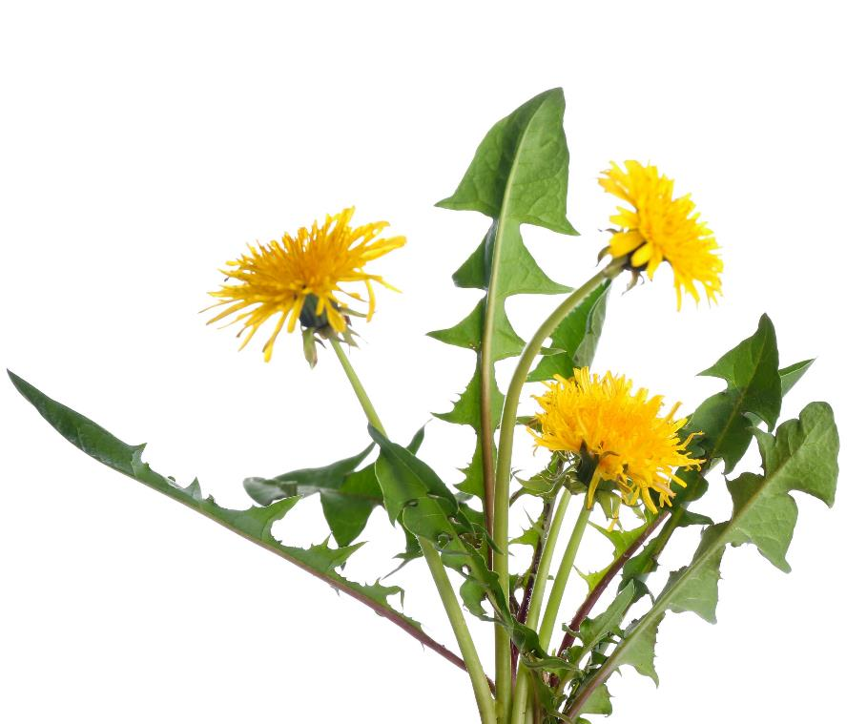
Have you seen this plant before?
What do you know about it?
  What is it called?
  Where do you see it?
  Can you eat it?
Dandelions have been used as food and medicine for a long time!

Slide 4
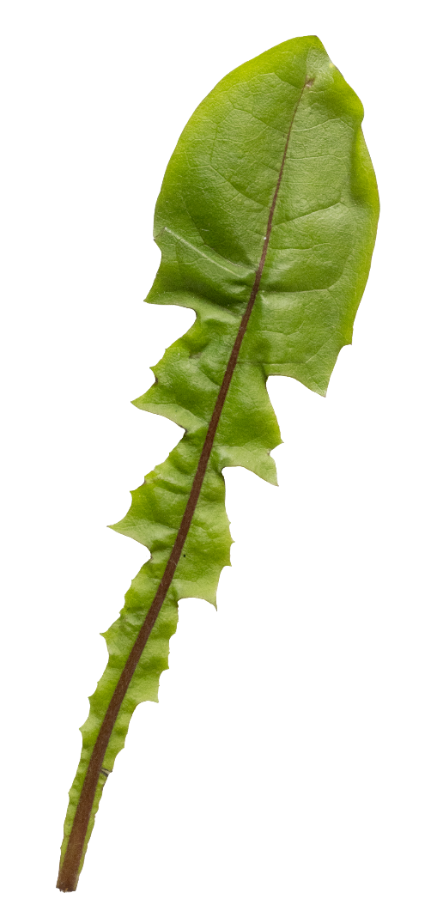
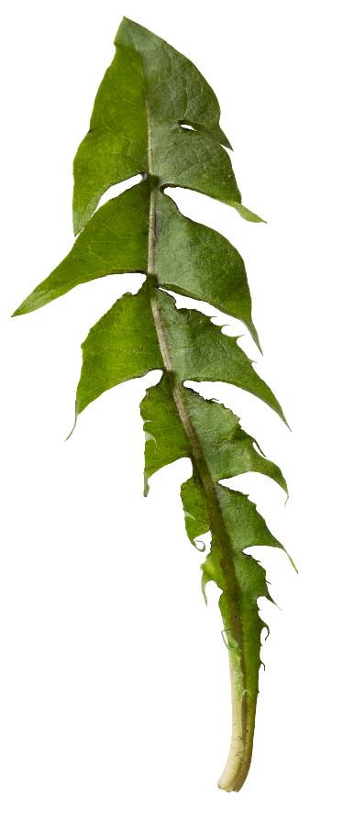
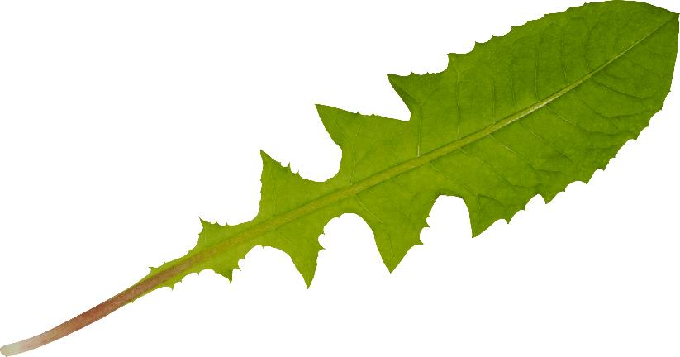
What do these dandelion leaves have in common?
Write a description that describes all three leaves.
Notes:
Learners list as many similarities as they can.
When learners have run out of ideas, reveal that all of them are dandelion leaves.

Slide 5
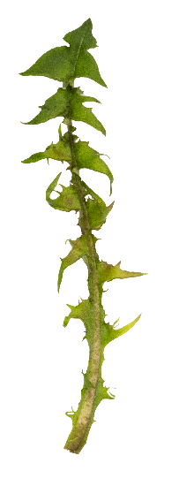
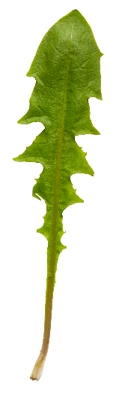
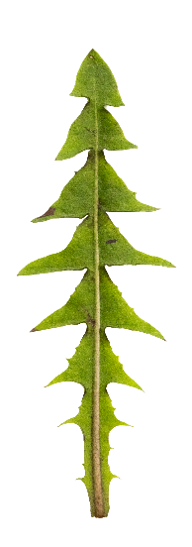
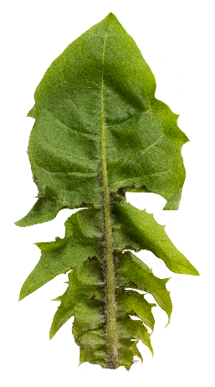
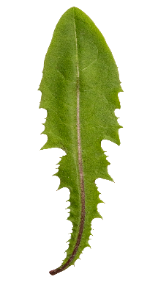

There are more than 200 species of dandelion in the UK!
Identifying them can be difficult because many species look similar. To make things harder, a species, or even a single plant, can grow in very different forms in response to its environment or events.
Examples:
A dandelion’s leaves can regrow in a very different shape after being mowed.
A species can look different when growing in full sun or shade.
Variation in dandelion leaves
Notes:
Knowing when differences in a characteristic are variations or indications of a different species is important for accurately measuring biodiversity.

Slide 6
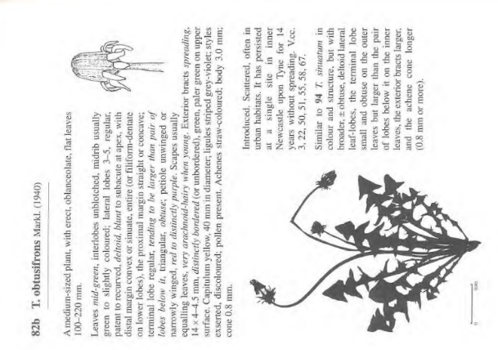
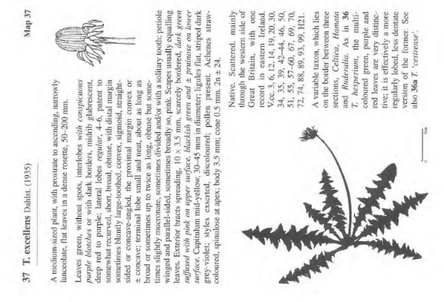
Identifying dandelions requires referring to very detailed descriptions of each species or using genetic testing.
Some types of dandelion are rare and only found in small areas. This is partly because dandelions can produce seeds without pollination, meaning one plant can clone itself into a large local population.
Pages from Dandelions of Great Britain and Ireland. (1997). Dudman, A.A.; Richards, A.J.
Notes:
Looking at physical descriptions of plant is still how most species identification is done in the field. Genetic testing is increasingly identifying instances where physical characteristics that look like natural variation are clustered and passed down in ways that suggest they may count as separate species or sub-species.
The ‘common dandelion’ is an example of a species complex. A group of closely related organisms that are similar in appearance and difficult to distinguish, usually requiring genetic testing to differentiate. In the case of dandelions, many of the species in the complex only occur in small areas. The physical and genetic differences may represent adaptations to these very local conditions.
In these images “T.” is short for Taraxacum, the scientific name for the genus that dandelions belong to. It is thought that this comes from an Arabic word meaning “bitter herb”.
obtusifrons means ‘blunt’ forehead and refers to the shape of the flower head when it is closed.
excellens means ‘excellent’. What makes this type of dandelion excellent?

Slide 7
Parts of a leaf
Tip
Margin
Blade
Veins
Midrib
Petiole
Leaf base

Slide 8
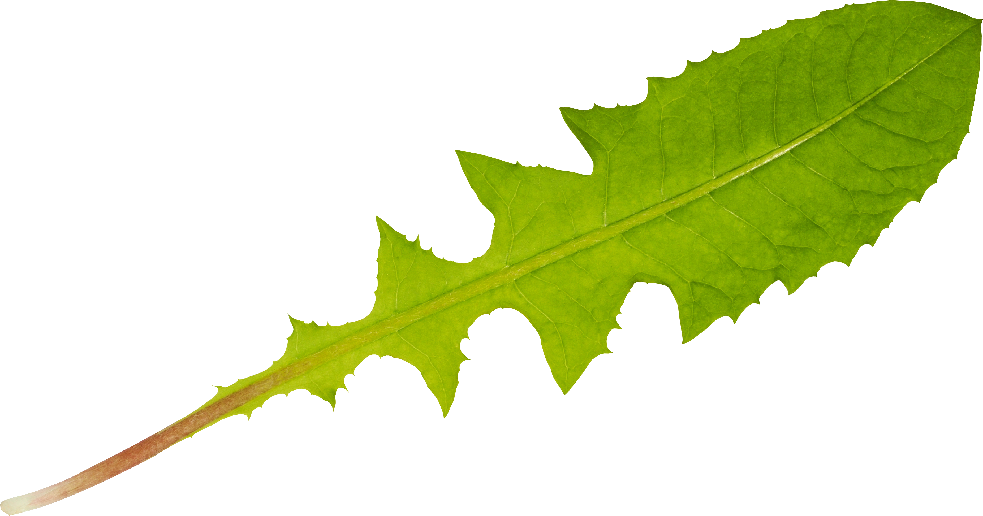
Parts of a leaf
Margin
Tip
Veins
Leaf base
Midrib
Blade
Petiole

Slide 9
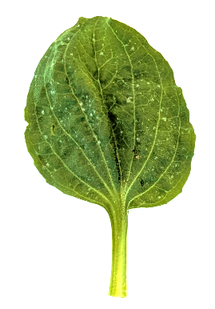
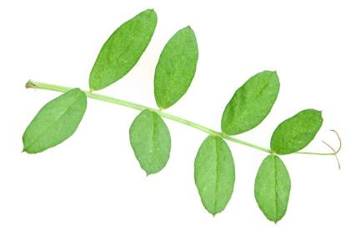
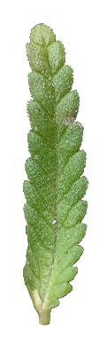
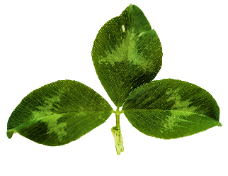
Leaf shapes
Simple |  |  | Compound
Illustration | Examples |  | Illustration | Examples
Simple leaves have one blade on a petiole (peh-TEE-ol). |  |  | Compound leaves have more than one blade connected to the petiole by short stalks called rachises (ra-KIS-es). These small blades are called leaflets.
Notes:
Rachises (ra-KIS-es). Singular - rachis (ra-KIS)

Slide 10
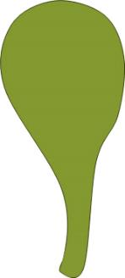

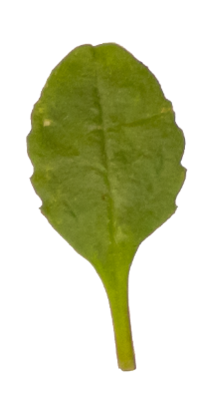
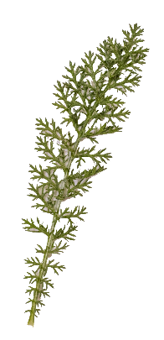
Leaf shapes
Lanceolate | Oval | Spatulate | Fern or feather
Notes:
Memory aids
Lanceolate – A lance is a long, pointed weapon similar to a spear.
Spatulate – A spatula is a cooking tool with a narrow handle and a wide top.

Slide 11
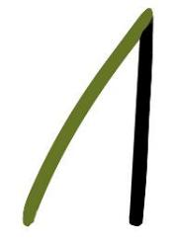
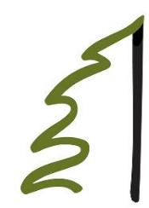
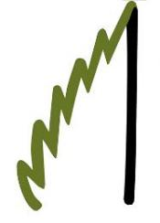
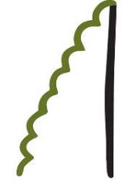
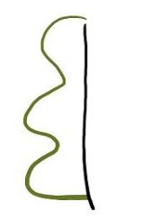
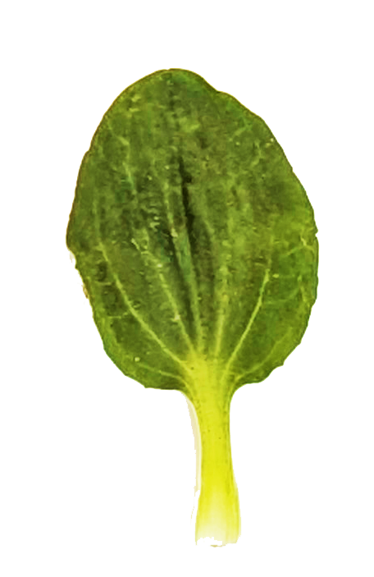
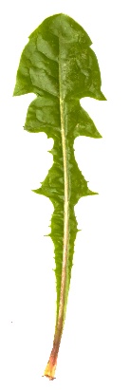
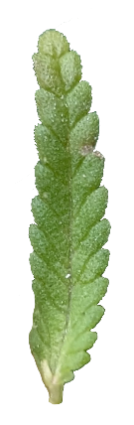
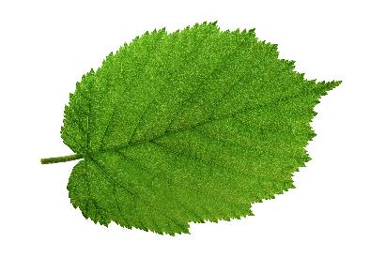
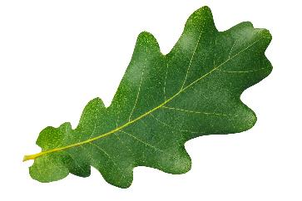
Leaf margins
Entire | Dentate | Serrate | Crenate | Lobate
Smooth | With larger tooth-like points | With many small pointed parts | With many rounded bumps | With large, rounded bumps
Notes:
Memory aids
Entire (en-TIE-er) – The line of the edge is a smooth, unbroken, line.
Dentate (den-TATE) – Like the teeth of a lion. You go to a dentist to look after your teeth.
Serrate (ser-RATE) – Like the edge of a saw or steak knife, these have serrated edges.
Crenate (cren-ATE) – The top of a castle wall has evenly spaced blunt bits called crennelations.
Lobate (lobe-ATE) – Rounded like a person’s ear lobe

Slide 12
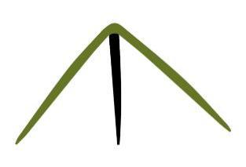
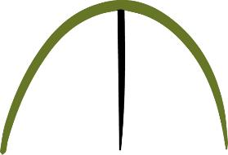
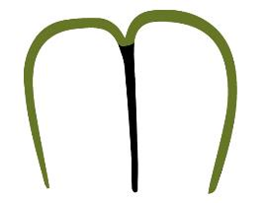
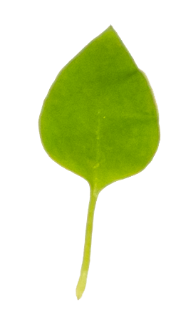
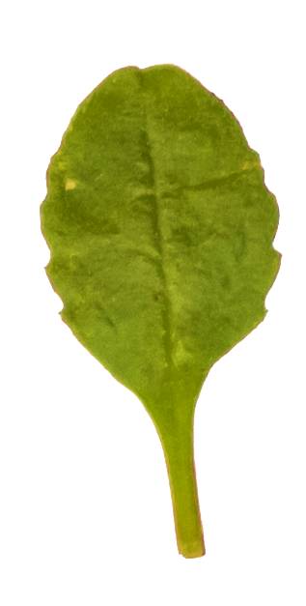

Leaf tips
Pointed | Rounded | Obcordate
Notes:
Obcordate (ob-CORE-date) – Heart-shaped with the narrow end of the heart at the petiole.

Slide 13


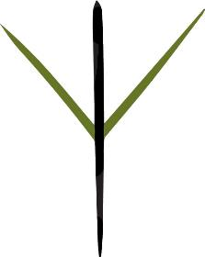
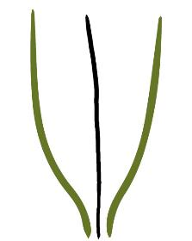
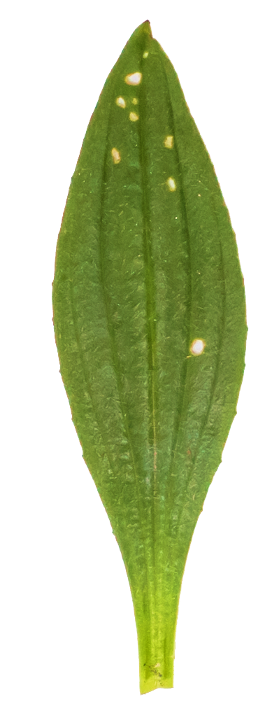
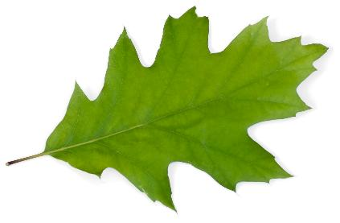
Leaf bases
Rounded | Cordate | Cunate | Tapered
Notes:
Memory aids
Cordate (CORE-date) – Heart-shaped with the narrow end of the heart at the leaf tip. The French for heart is ‘coeur’, which is from latin ‘cord’ meaning ‘heart’.
Cunate (Cue-NATE) – Wedge-shaped. Ancient Mesopotamian writing is called cuneiform, because it looks like small wedges.

Slide 14
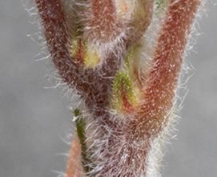
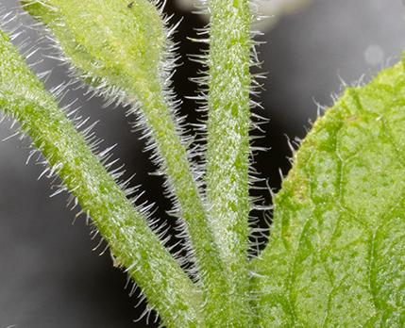
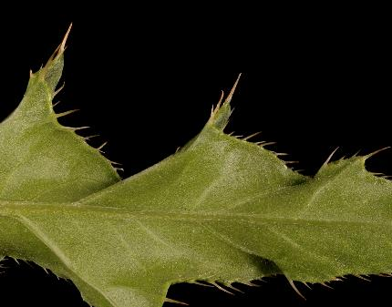
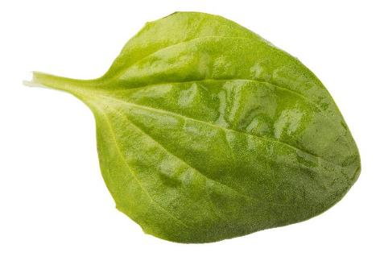
Leaf surfaces
Glabrous | Pubescent | Hispid | Spiny
Without hairs | With hairs | With coarse hairs | With sharp, stiff points
Notes:
Memory aids
Glabrous (GLA-brus)
Pubescent (pue-BES-sent)
Hispid (HISS-pid)

Slide 15

Put together a description of this leaf
This leaf is simple.
The shape is oval.
The tip is rounded.
The margin is entire.
The base is rounded.
Greater plantain leaf

Slide 16
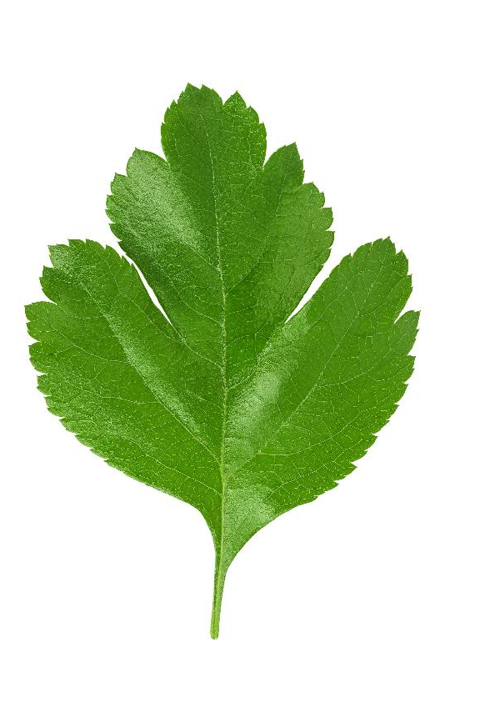
It’s okay to use more than one word for each part of the leaf
This leaf is simple.
The tip is round.
The edge is lobed and serrated.
The base is cunate or tapered.
Many species have leaves that can be variable in shape. In these cases, more than one word is used to describe the range of shapes a feature can have.
Hawthorn leaf

Slide 17
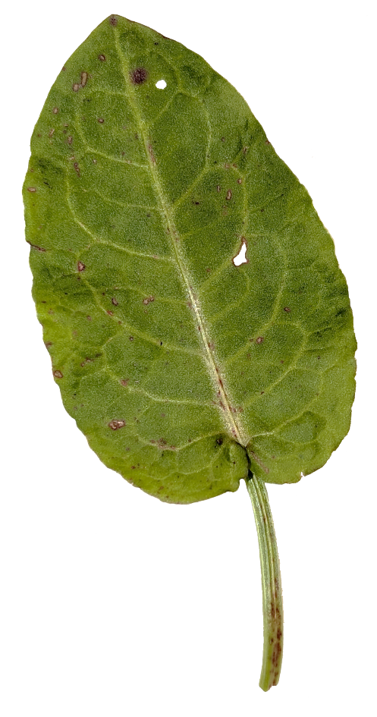
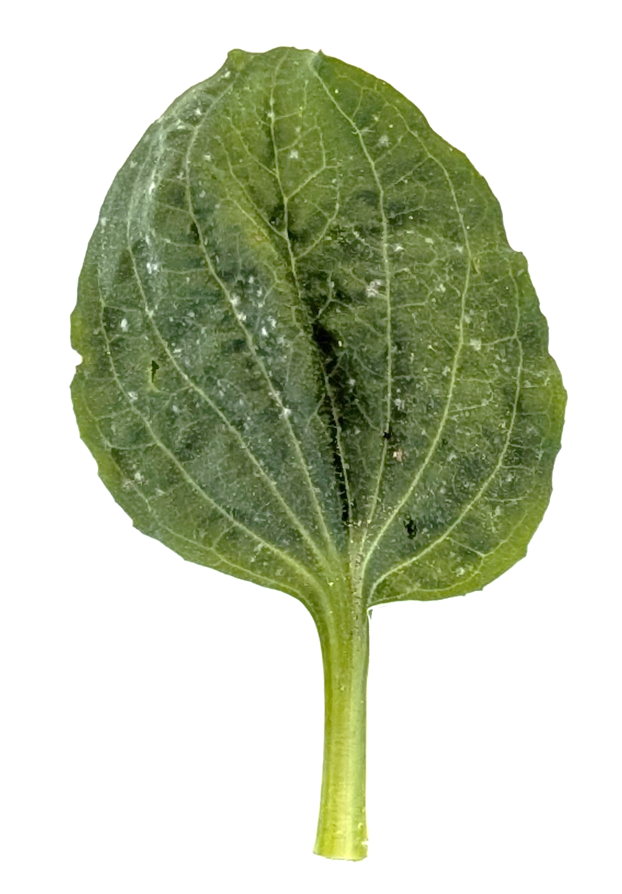
Describe as many differences as you can
Dock leaf
Greater plantain leaf

Slide 18

Revisit your description of dandelion leaves
Adjust your description to use botanical vocabulary.

Slide 19
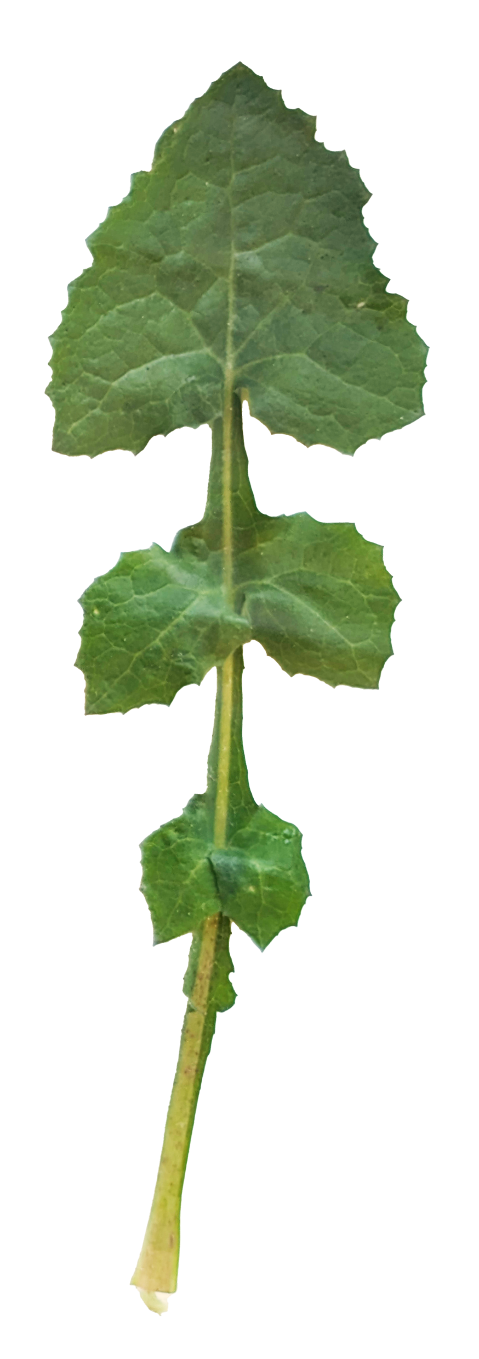
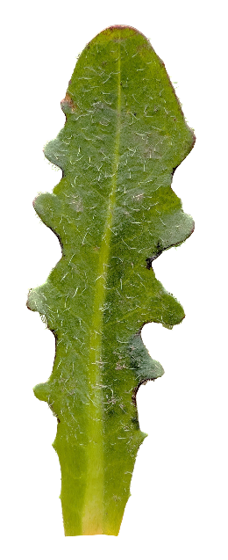
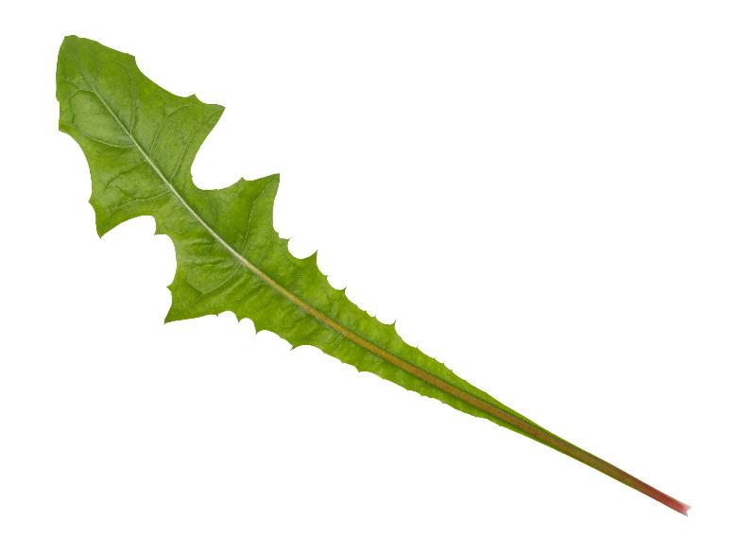
Which of these leaves is from a dandelion?
Smooth sow thistle
Dandelion
Cat’s ear
Notes:
Smooth sow thistle and Cat’s ear belong to the same plant family as the dandelion, the daisy family. This is one of the largest plant families. Many have similar-looking leaves and are easily misidentified at first glance.

Slide 20


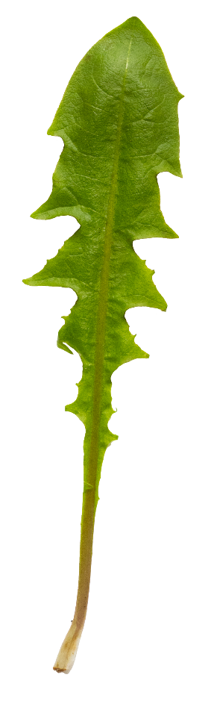
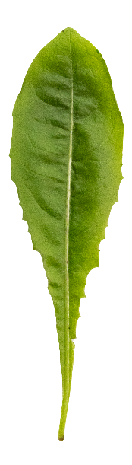


These are all dandelion leaves.
Would your description include them all?

Slide 21
Extra detail

Slide 22

Leaf or leaflet?
To tell where a leaf starts, look at where the broad part of the leaf meets the stalk.
Leaves usually have a lump where the leaf stalk meets the stem.
This lump is a bud.
Bud
No bud

Slide 23

Leaf or leaflet?
No bud
Buds grow into new stems or flowers.
Bud grown into a new stem

Slide 24

Leaf or leaflet?
Leaflets
Leaflets do not have buds where they meet the rachis (ra-KIS) or petiole (peh-TEA-ol).
Leaf
Bud

Slide 25
Activity ideas

Slide 26
Make descriptions more scientific
The descriptions of leaves in the Grassland Plant Survey are written so that most people, including younger people, can understand the descriptions. This means the descriptions are written using simplified language.
Rewrite the description for one of the leaves to use more scientific language.

Slide 27
Recording variation
The Grassland Plant Survey asks learners to record the coverage of 9 indicator species. Extend the information collected by selecting one of the indicator species and recording detailed information about the range of morphology they can find.
For example, learners might describe the different dandelion leaf shapes they find, record where they find each form, and look for correlations between the shape of the leaves and other conditions.

Slide 28
Searching or prompting
Even with modern technology, search terms and AI prompt engineering are important skills that require the use of detailed descriptive vocabulary. Here are two ideas for practising these skills and using leaf vocabulary.
Type a description of a leaf into a search engine.
Does it return results that look like the leaf they have drawn?
Input the description for a leaf into a generative AI model.
Does it generate a leaf image that looks like your leaf?

